Slide 1
Title IX for Employees
Carol Wuenschel
Executive Director for Human Resources
and Title IX Coordinator
2020

Slide 2
What is new in Title IX regulations
Terminology
Standard of Evidence
What Constitutes Notice
Responsible Employees
Mandatory Dismissal
Advisors
Interim Measures
Timing of Review and Comment Period
Live Hearings and Decision Makers
Cross-Examination
Training Materials Publication

Slide 3
Terminology - What’s old is new again
Complainant – formerly known as complaining party
Respondent – formerly known as responding party
Recipient – institution that receives federal funding
Sexual Harassment – (1) quid pro quo by an employee; (2) unwelcome conduct that discriminates based on sex that is so severe, pervasive and objectively offensive that it denies a person equal access to the College’s education program and/or activity; (3) includes sexual assault, dating violence, domestic violence and stalking

Slide 4
Standard of Evidence
Preponderance of Evidence –
more likely than not that it occurred

Slide 5
What constitutes notice
Actual notice to Title IX Coordinator
Must be a formal complaint
Written
Online form
Must respond promptly in a manner that is not “deliberately indifferent”

Slide 6
Mandatory Reporters
Sample script:
“I am sorry that this has happened to you.”
“Do you need medical attention or do you wish to speak to a confidential counselor. There are people ready to help you during this difficult time.”
“I need to let you know that I need to report what has happened to you to the Title IX coordinator.”
“I am legally mandated to share information about this incident including your name.”
“The Title IX coordinator will be reaching out to you to explain your options under the College’s Title IX Policy should you wish to pursue disciplinary or criminal action against the other party.”
“What questions do you have?”
“What other support can I or the College provide to you at this time?”
“Please don’t try to handle this on your own. You have experienced some serious trauma and you deserve to use available resources to help you.”
Hood College employees, including faculty and staff, are strongly encouraged to report allegations of gender discrimination, sexual harassment, sexual assault, dating violence, domestic violence and stalking to the Title IX Coordinator to maximize the institution's ability to investigate and potentially address and eliminate the misconduct. The employee should NOT attempt to determine if the harassment or violence actually did occur, or if a hostile environment is being created.
What should a mandatory reporter do if an individual discloses that the person is a victim of a sexual assault or other sexual misconduct?
C – Create a safe space and demonstrate compassion
A – Address concerns and discuss options
R – Report to Title IX Coordinator
E – Empower victim to make choices

Slide 7
Mandatory Dismissal
The conduct alleged in the formal complaint would not constitute sexual harassment under Title IX regulations; and/or
The conduct did not occur in an educational program or activity controlled by the Hood College (including buildings or property controlled by recognized student organizations), and the Hood College does not have control over the Respondent; and/or
The conduct did not occur against a person in the United States; and/or
At the time of filing a formal complaint, a Complainant is not participating in or attempting to participate in the education program or activity of the recipient.
Does not prevent cause of action under another policy

Slide 8
Advisors
Role has been formalized in new Title IX regulations
Required for sexual harassment cases
If either party shows up at the live hearing without an advisor, one will be appointed for that party
Party cannot fire the advisor during a hearing
College can fire an advisor if the individual will not conduct the cross-examination during live hearing
Accompany a Complainant or Respondent to meetings with investigators
Review evidence and investigation reports
Cross examine the opposing party during a live hearing
Questions are provided by Complainant or Respondent
The Title IX Advisor is not responsible for developing the questions asked during a live hearing

Slide 9
Interim Measures
Confidential non-disciplinary, non-punitive individualized services offered as appropriate, as reasonably available, and without fee or charge to restore or preserve equal access to the recipient’s education program or activity without unreasonably burdening the other party
Including measures to protect the safety of all parties or the recipient’s educational environment, or deter sexual harassment
May include counseling services, extensions of deadlines or other course-related adjustments, modifications of work or class schedules, campus escort services, mutual restrictions on contact between parties, changes in work or housing locations, leaves of absence, increased security and monitoring of certain areas of the campus
Must consider complainant’s wishes and must provide the information even if a formal complaint is not filed
The § 106.30 definition of ‘‘supportive measures’’ permits recipients to provide either party, or both parties, individualized services, without fee or charge, before or after filing a formal complaint, or where no formal complaint has been filed.

Slide 10
Timing of Review and Comment Period
Parties must have at least 10 days to submit a written response, which the investigator will consider prior to completion of the investigative report
All comments must be included in the final investigation report with reason why or why not the information was not considered

Slide 11
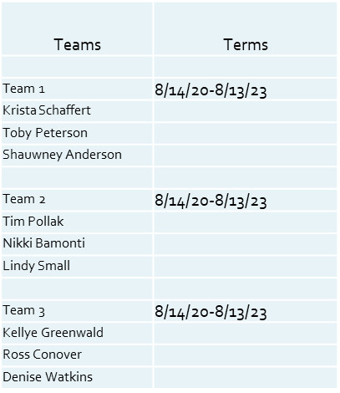
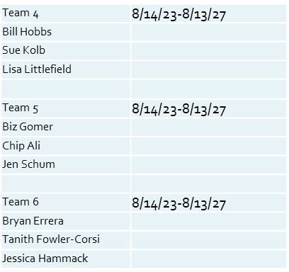
Live Hearings and Decision-makers
Live – conducted with both parties and their advisors in separate locations through the use of technology
Decision-makers – Hearing Panel, Hearing Panel Chair
VPs – Consultants for Sanctions
Appeals Officials
VPs for Sanctions
Student Respondent | VP of Student Life
Faculty Respondent | Provost
Staff Respondent | VP of Finance
Appeals Officials
Student Respondent | VP for Institutional Advancement
Faculty respondent | VP for Marketing
Staff Respondent | VP for Enrollment Management

Slide 12
Cross-Examination
Party’s advisor asks the questions
Cannot ask the same question twice or a variation of the question
Cannot bully or badger the other party
Hearing Panel chair rules on relevance of each question with the point of law

Slide 13
Training Materials must be published
106.45 (b)(10)(D)
Publish on the College’s website all materials used to train:
Title IX Coordinator
Decision-makers
Appeals Officials
Mediators (Chaplain and Ombudsperson)

Slide 14
Flowchart of Process

Slide 15
Questions
Carol Wuenschel, Executive Director of Human Resources and Title IX Coordinator
Wuenschel@hood.edu
(301) 696-3556
Charles G. Mann, Vice President for Finance
mann@hood.edu
(301) 696-3611

